Slide 1
FUNDAMENTALS OF ACCOUNTING FOR NON-ACCOUNTANTS

Slide 3
STUDENT LEARNING OUTCOMES
A. Know and understand the trial balance and its use.
B. Know the mechanics of preparing the trial balance to summarize effects of transactions to account titles or values.
C. Know and understand the mechanics of financial statement preparation.
D. Appreciate the importance of preparing financial statements.
E. Actualize skills in preparing financial statements.

Slide 4
Accounting Process
Recording
Classifying
Summarizing
Interpreting
Recording of Transactions in the Journal
Posting of Transactions in the Ledger
Preparation of Worksheet, adjusting entries, and financial statements
Analysis of Financial Statements

Slide 5
The Trial Balance
The trial balance is a summary report that shows the balances of open ledger accounts (Kimwell 2007). By open accounts, we mean, those accounts in the general ledger which balances are not yet reduced to zero. The trial balance, therefore, gives us a snap view of the different accounts and amounts of the business as of a given period of time.

Slide 6
The Trial Balance
The trial balance can be prepared using two approaches – the trial balance of totals, and the trial balance of balances. The trial balance of totals is a trial balance that shows the total of the debit and the credit columns of each of the accounts in the ledger (Edmond et al 2014). The trial balance of balances, on the other hand, only shows the balance of the figures shown in the ledger, meaning the difference between the debit and credit amounts (Ballada 2008)

Slide 7
The Financial Statements
1. Income Statement – The income statement is currently known as the Statement of Financial Operations, or Statement of Comprehensive Income. This practically shows the results of operations of the business for a period of time.
2. Balance Sheet – currently known as Statement of Financial Position shows the financial condition of a business as of a given period of time. It tells us how much assets, liabilities, and capital, the business has as of particular period.
3. Statement of Changes in Equity – is a statement that presents the changes in the capital account. These changes can be additional investments, income or loss, and withdrawals.

Slide 8
Preparing the Financial Statements
We prepare the financial statements in the following order:
We prepare first the trial balance. The trial balance is the basis in our preparation of financial statements.
First, we prepare the income statement. The end figure of the income statement, which is net income, is needed to prepare the statement of changes in equity.
Secondly, we prepare the statement of changes in equity. As earlier mentioned, we need the net income figure to be able to prepare this statement.
Finally, we prepare the balance sheet. In preparing the balance sheet, we need the ending capital balance from the statement of changes in equity. This is the reason why we prepare this last.

Slide 9
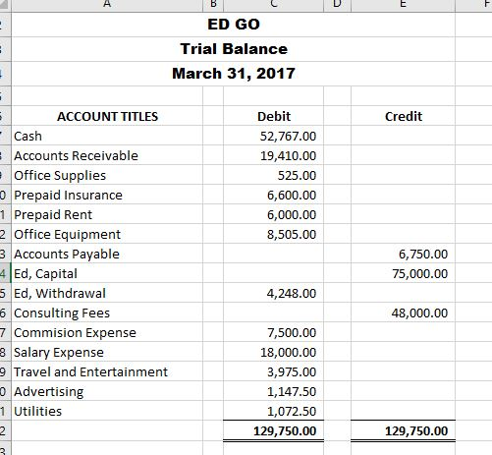

Slide 10
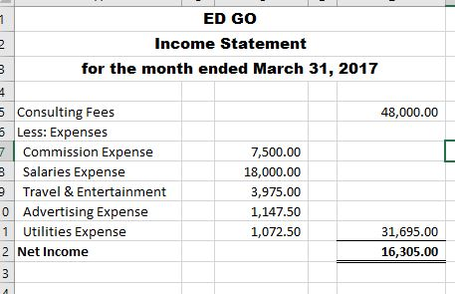

Slide 11
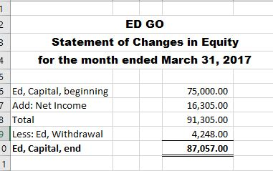

Slide 12
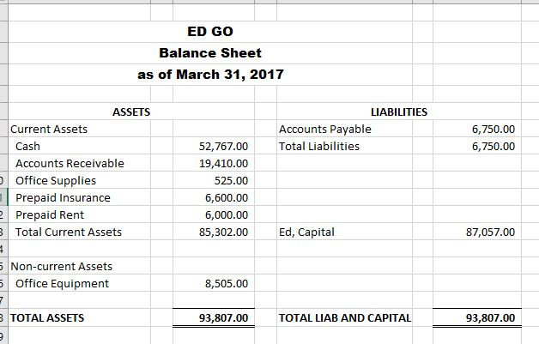
The above format of the balance sheet is called the account form.

Slide 13
ED GO
Balance Sheet
as of March 31, 2017
ASSETS
Current Assets
Cash |  | 52,767.00
Account Receivable |  | 19,410.00
Office Supplies |  | 525.00
Prepaid Insurance |  | 6,600.00
Prepaid Rent |  | 6,000.00
Total Current Assets |  | 85,302.00
Non-current Assets
Office Equipment |  | 8,505.00
TOTAL ASSETS |  | 93,807.00
LIABILITIES
Accounts Payable |  | 6,750.00
Total Liabilities |  | 6,750.00
CAPITAL
Ed, Capital |  | 87,057.00
TOTAL LIABILITIES & CAPITAL |  | 93,807.00
The above format of the balance sheet is called the alternative form.

Slide 14
Other Notes: Adjusting and Closing Entries
These are the preparation of adjusting entries and closing entries.
1. Adjusting Entries – are prepared to ensure that revenues reflected in the financial statements are earned and expenses are incurred at the end of the accounting period. For example, when a business records supplies expense every time a purchase of supplies was made, an inventory of unused supplies at the end of an accounting period can be done. If there are unused supplies, the unused portion of the supplies expense needs to be recognized and the supplies expense needs to be adjusted, to properly reflect this situation.

Slide 15
2. Closing entries are prepared at the end of an accounting period, normally at the end of the year, to transfer the values of nominal accounts (revenues and expenses, including drawing) to real accounts (assets, liabilities, and capital). The process of preparing closing entries involve closing the revenue, expense, and drawing accounts to the capital account either in one single entry or three different entries. A post-closing trial balance is then made to show the remaining balances for all real accounts.

Slide 16
An example is provided below based on Ed Go’s financial statements:
A. To close revenue against capital, the entry would be to simply debit revenues (consulting Fees) and credit capital account:
Consulting Fees 48,000.00
Ed, Capital 48,000.00
B. To close expense accounts against capital, the entry would be to debit the capital account and credit all expenses accounts.
Ed, Capital 31, 695.00
Commission Expense 7,500.00
Salary Expense 18, 000.00
Travel and Entertainment 3, 975.00
Advertising 1,147.50
Utilities 1, 072.50

Slide 17
C. To close drawing against capital, the entry is to debit capital and credit the drawing account.
Ed, Capital 4, 248.00
Ed, Drawing 4, 248.00
These entries are then posted in the ledger, after which a post-closing trial balance can then be made.

Slide 18
What is a Post-Closing Trial Balance?
A post-closing trial balance is a listing of all balance sheet accounts containing non-zero balances at the end of a reporting period. The post-closing trial balance is used to verify that the total of all debit balances equals the total of all credit balances, which should net to zero. The post-closing trial balance contains no revenue, expense, gain, loss, or summary account balances, since these temporary accounts have already been closed and their balances moved into the retained earnings account as part of the closing process.

Slide 19
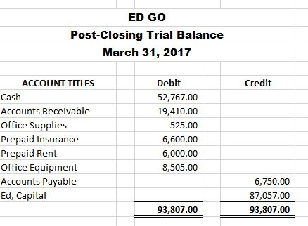
Constructively, after the preparation of closing entries, all revenue, expense, and drawing accounts are reduced to zero. These three accounts are called nominal accounts because their balances pertain only to a specific accounting period and are not carried over to the next. Real accounts (assets, liabilities, and capital) are accounts whose balances are carried over from one accounting period to another.

Slide 20
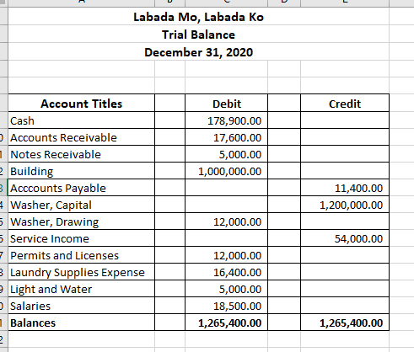
Exercise 1.
Problem Solving 1. Prepare the financial statements (Income Statement, Balance Sheet, Statement of Changes in Equity) based on the trial balance below.
From the trial balance presented below, prepare the financial statements of Labada Mo, Labada Ko.

Slide 21


Slide 22
CLOSING PRAYER

Slide 23


